Slide 1
Department of Computer Science & Business Systems SUBJECT: Usability Design of Software Applications Subject Code: Topic Name: Usability Design of Software Applications IV year, Sec: A
Vallurupalli Nageswara Rao Vignana Jyothi Institute of Engineering &Technology
Bhagya Rekha Konkepudi
Assistant Professor
Email: bhagyarekha_k@vnrvjiet.in
<Web link of your created resource if any>

Slide 2
Agenda
Introducing Evaluation
Introduction
The Why, What, Where, and When of Evaluation
Types of Evaluation
Heuristic Evaluation:
10 Heuristic Principles,
Examples of Heuristic Evaluation:
Group Assignment initiation (Website and App)
Evaluation of key tasks of the app or website for heuristic principles,
severity, recommendations.

Slide 3

Introduction To Evaluation
Imagine you have designed an app for teenagers to share music, gossip, and photos. You have prototyped your first design and implemented the core functionality. How would you find out whether it would appeal to them and if they will use it? You would need to evaluate it – but how?

Slide 4

Introduction To Evaluation
Evaluation is integral to the design process. Evaluators collect information about users or potential users’ experiences when interacting with a prototype, an app, a computer system, a component of a computer system, an application, or a design artifact such as a screen sketch. They do this to improve its design. The evaluation focuses on the usability of the system (e.g. how easy it is to learn and use) and on the users’ experience when interacting with it (e.g. how satisfying, enjoyable, or motivating the interaction is).

Slide 5

Introduction To Evaluation
What to Evaluate
What to evaluate ranges from low-tech prototypes to complete systems; a particular screen function to the whole workflow; and from aesthetic design to safety features.
For example:
Developers of a new web browser may want to know if users find items faster with their product.
Developers of an ambient display may be interested in whether it changes people's behavior.
Game app developers will want to know how engaging and fun their games are and how long users will play them.
Government authorities may ask if a computerized system for controlling traffic lights results in fewer accidents or if a website complies with the standards required for users with disabilities.
Makers of a toy may ask if 6-year-olds can manipulate the controls and whether they are engaged by its furry case, and whether the toy is safe for them to play with.
A company that develops personal, digital music players may want to know if the size, color, and shape of the casing are liked by people from different age groups living in different countries. A software company may want to assess market reaction to its new homepage design.

Slide 6

Introduction To Evaluation
Where to Evaluate
Where evaluation takes place depends on what is being evaluated.
Different Scenarios as Examples that can be considered here:
Some characteristics, such as web accessibility, are generally evaluated in a laboratory because it provides the control necessary to systematically investigate whether all requirements are met.
This is also true for design choices, such as choosing the size and layout of keys for a smartphone.
User experience aspects, such as whether children enjoy playing with a new toy and for how long before they get bored, can be evaluated more effectively in natural settings which are often referred to as ‘in the wild studies.
Remote studies of online behavior, such as social networking, can be conducted to evaluate natural interactions for a lot of participants in their own homes, cheaply and quickly.
Living laboratories have also been built which are somewhere in between labs and in the wild settings; providing the setting of being in an environment, such as the home, while also giving the ability to control, measure, and record activities.

Slide 7

Introduction To Evaluation
When to Evaluate
At what stage in the product lifecycle evaluation takes place depends on the type of product.
the product being developed could be a brand-new concept or it could be an upgrade of an existing product.
If the product is new, then considerable time is usually invested in market research and establishing user requirements. Once these requirements have been established, they are used to create initial sketches, a storyboard, a series of screens, or a prototype of the design ideas. These are then evaluated to see if the designers have interpreted the users’ requirements correctly and embodied them in their designs appropriately. The designs will be modified according to the evaluation feedback and new prototypes developed and subsequently evaluated., such as the home, while also giving the ability to control, measure, and record activities.
Evaluations that are done to assess the success of a finished product are known as summative evaluations.
If the product is being upgraded then the evaluation may not focus on establishing a set of requirements, but may evaluate the existing product to ascertain what needs improving. Features are then often added, which can result in new usability problems. Other times, attention is focused on improving specific aspects, such as enhanced navigation.

Slide 8
Types of Evaluation
The evaluations are classified into three broad categories, depending on the setting, user involvement, and level of control. These are:
Controlled setting involving users
users’ activities are controlled in order to test hypotheses and measure or observe certain behaviors. The main methods are usability testing and experiments.
examples are laboratories and living labs
Natural settings involving users
There is little or no control of users’ activities in order to determine how the product would be used in the real world. The main method used is field studies.
examples are online communities and products that are used in public places
Any settings not involving users
consultants and researchers critique, predict, and model aspects of the interface in order to identify the most obvious usability problems. The range of methods includes inspections, heuristics, walkthroughs, models, and analytics.

Slide 9
Controlled setting involving users
Controlled settings enable evaluators to control what users do, when they do it, and for how long. They also enable evaluators to reduce outside influences and distractions, such as friends or colleagues talking. The approach has been extensively and successfully used to evaluate software applications running on PCs and other technologies where participants can be seated in front of them to perform a set of tasks.
Usability testing
Typically this approach to evaluating user interfaces involves collecting data using a combination of methods – i.e. experiments, observation, interviews, and questionnaires – in a controlled setting.
It is generally done in laboratories although increasingly it is being done remotely or in natural settings.
The primary goal is to determine whether an interface is usable by the intended user population to carry out the tasks for which it was designed.
This involves investigating how typical users perform on typical tasks. By typical we mean the users for whom the system is designed and the things that it is designed for them to be able to do (e.g. buy the latest fashions).
It often involves comparing the number and kinds of errors that the users make and recording the time that it takes them to complete the task. As users perform the tasks, they may be recorded on video; their interactions with the software may also be recorded, usually by logging software.
User satisfaction questionnaires and interviews can also be used to elicit users’ opinions about how they found the experience of using the system. It can be supplemented by observation at product sites to collect evidence about how the product is being used in work or other environments.

Slide 10
Controlled setting involving users
Usability testing - Example
an experiment comparing which is the best way for users to enter text when using a tablet interface would control all other aspects of the setting to ensure they do not affect the performance. The following steps are followed:
These include providing the same instructions to the participants, using the same tablet interface, and asking the participants to do the same tasks.
The conditions that might be compared could be:
typing using a virtual keyboard,
typing using a physical keyboard, and
swiping using a virtual keyboard (sliding across the keys to select letters).
The aim of the experiment would be to test whether one is better than the other in terms of speed of typing and number of errors.
A number of participants would be brought into the lab separately to carry out a predefined set of text entry tasks and their performance measured in terms of time taken and any errors made, e.g. selecting the wrong letter.
The data collected would then be analyzed to determine if the scores for each condition were significantly different. If the performance measures obtained for the virtual keyboard was significantly faster than the other two and had the least number of errors, it could be possible to say that this method of text entry is the best.

Slide 11
Natural settings involving users
The aim of field studies is to evaluate people in their natural settings. They are used primarily to:
help identify opportunities for new technology;
establish the requirements for a new design; and
facilitate the introduction of technology or inform deployment of existing technology in new contexts.
Methods that are typically used are observation, interviews and focus groups, and interaction logging.
The data takes the form of events and conversations that are recorded by the researchers as notes, by audio or video recording, or by the participants, as diaries and notes. A goal is to be unobtrusive and not to affect what people do during the evaluation.
Example:
A researcher might be interested in observing how a new mobile navigation device will be used in urban environments.
To conduct the study they would need to recruit people who are willing to use the device for a few weeks or months in their natural surroundings. They might then tell the participants what they can do with the device. Other than that, it is up to the participants to decide how to use it and when, as they move between their work or school, home, and other places.

Slide 12
Any settings not involving users
Evaluations that take place without involving users are conducted in settings where the researcher must imagine or model how an interface is likely to be used. Inspection methods are commonly employed to predict user behavior and to identify usability problems, based on knowledge of usability, users’ behavior, the contexts in which the system will be used, and the kinds of activities that users undertake.
Examples include a heuristic evaluation that applies knowledge of typical users guided by rules of thumb and walkthroughs that involve stepping through a scenario or answering a set of questions for a detailed prototype. Other techniques include analytics and models.
The original heuristics used in the heuristic evaluation were for screen-based applications (Nielsen and Mack, 1994; Nielsen and Tahir, 2002). These have been adapted to develop new sets of heuristics for evaluating web-based products, mobile systems, collaborative technologies, computerized toys, and other new types of systems.

Slide 13
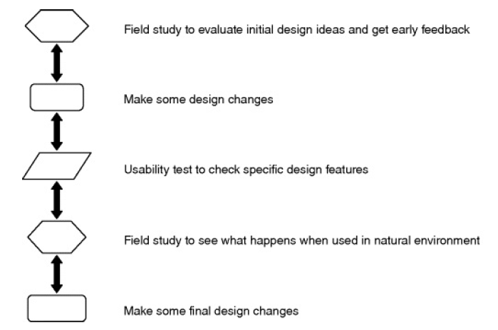
Choosing and Combining Methods
The three broad categories identified above provide a general framework to guide the selection of evaluation methods.
Often combinations of methods are used across the categories to obtain a richer understanding.
For example, sometimes usability testing in labs is combined with observations in natural settings to identify the range of usability problems and find out how users typically use a product.
Figure illustrates one way in which laboratory-based usability testing and field studies in natural settings can be combined to evaluate a mobile application – e.g. for a smartphone.
Example of the way laboratory-based usability testing
and field studies can complement each other

Slide 14
Evaluation: Inspections, Analytics, and Models
Sometimes users are not easily accessible, or involving them is too expensive or it takes too long.
In such circumstances, other people usually referred to as experts, can provide feedback. These are people who are knowledgeable about both interaction design and the needs and typical behavior of users.
Various inspection methods were developed as alternatives to usability testing in the early 1990s, drawing on software engineering practice where code and other types of inspections are commonly used. Inspection methods for interaction design include heuristic evaluations, and walkthroughs, in which experts examine the interface of an interactive product, often role-playing typical users, and suggest problems users would likely have when interacting with it.
One of the attractions of these methods is that they can be used at any stage of a design project. They can also be used to complement user testing.

Slide 15
Usability principles or Heuristics
Heuristic evaluation is a usability inspection method that was developed by Nielsen and his colleagues (Nielsen and Mohlich, 1990; Nielsen, 1994a) and others (Hollingshead and Novick, 2007), and later modified by other researchers for evaluating specific types of systems (e.g. Mankoff et al, 2003; Pinelle et al, 2009).
In heuristic evaluation, experts, guided by a set of usability principles known as heuristics, evaluate whether user-interface elements, such as dialog boxes, menus, navigation structure, online help, and so on, conform to tried and tested principles.
The original set of heuristics for HCI evaluation was developed by Jakob Nielsen and his colleagues who derived them empirically from an analysis of 249 usability problems (Nielsen, 1994b); a revised version of these heuristics is listed (Nielsen, 2014: useit.com)

Slide 16
Usability principles or Heuristics
Visibility of system status
The system should always keep users informed about what is going on, through appropriate feedback within a reasonable time.
Match between system and the real world
The system should speak the users’ language, with words, phrases, and concepts familiar to the user, rather than system-oriented terms. Follow real-world conventions, making information appear in a natural and logical
order.
User control and freedom
Users often choose system functions by mistake and will need a clearly marked emergency exit to leave the unwanted state without having to go through an extended dialog. Support undo and redo.
Consistency and standards
Users should not have to wonder whether different words, situations, or actions mean the same thing. Follow platform conventions.

Slide 17
Usability principles or Heuristics
Error prevention
Even better than good error messages is a careful design that prevents a problem from occurring in the first place. Either eliminate error-prone conditions or check for them and present users with a confirmation option before they commit to the action.
Recognition rather than recall
Minimize the user's memory load by making objects, actions, and options visible. The user should not have to remember information from one part of the dialog to another. Instructions for use of the system should be visible or easily retrievable whenever appropriate.
Flexibility and efficiency of use
Accelerators – unseen by the novice user – may often speed up the interaction for the expert user such that the system can cater to both inexperienced and experienced users. Allow users to tailor frequent actions.

Slide 18
Usability principles or Heuristics
Aesthetic and minimalist design
Dialogs should not contain information that is irrelevant or rarely needed. Every extra unit of information in a dialog competes with the relevant units of information and diminishes their relative visibility.
Help users recognize, diagnose, and recover from errors
Error messages should be expressed in plain language (no codes), precisely indicate the problem, and constructively suggest a solution.
Help and documentation
Even though it is better if the system can be used without documentation, it may be necessary to provide help and documentation. Any such information should be easy to search, focused on the user's task, list concrete steps to be carried out, and not be too large. Before reading on, watch the YouTube video developed by David Lazarus.

Slide 19

Heuristic evaluation of Swayam application — a UX case study
About SWAYAM
SWAYAM is a program initiated by the Government of India and designed to achieve the three cardinal principles of Education Policy viz., access, equity, and quality. The objective of this effort is to take the best teaching learning resources to all, including the most disadvantaged. SWAYAM seeks to bridge the digital divide for students who have hitherto remained untouched by the digital revolution and have not been able to join the mainstream of the knowledge economy.
Let’s see the evaluation of the Swayam web Application according to the 10 principles !!!

Slide 20
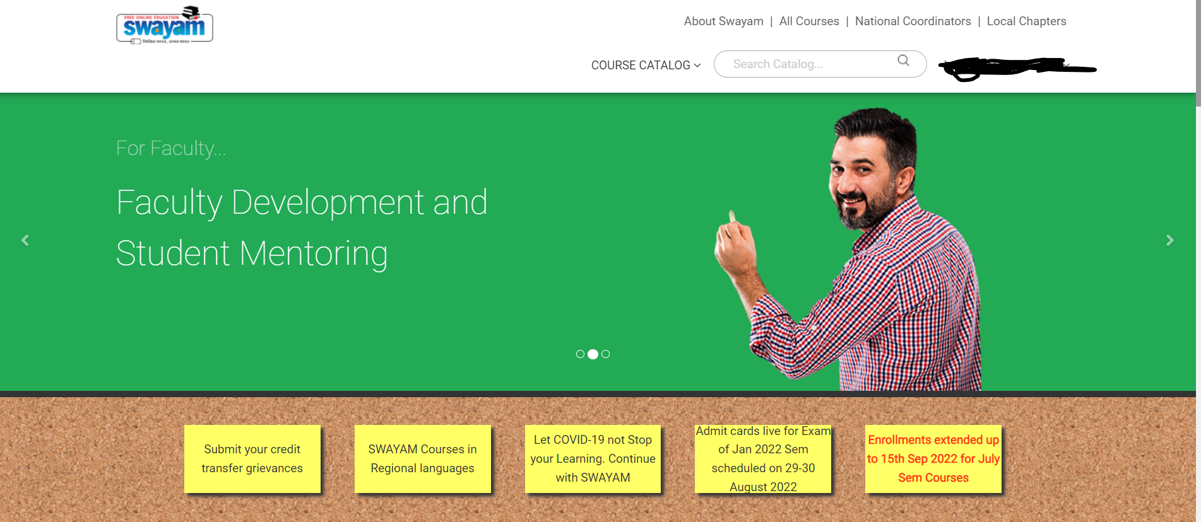
Heuristic evaluation of Swayam application — a UX case study
1. Visibility Of System Status
When a user searches for any product on Swayam or clicks on any Course/Go to Course/Progress/any other option in the web application, it does not shows “Please wait..”/ Loading. So the user will not have any information about the action being performed and to wait for the results.
Heuristic Violated: Yes

Slide 21
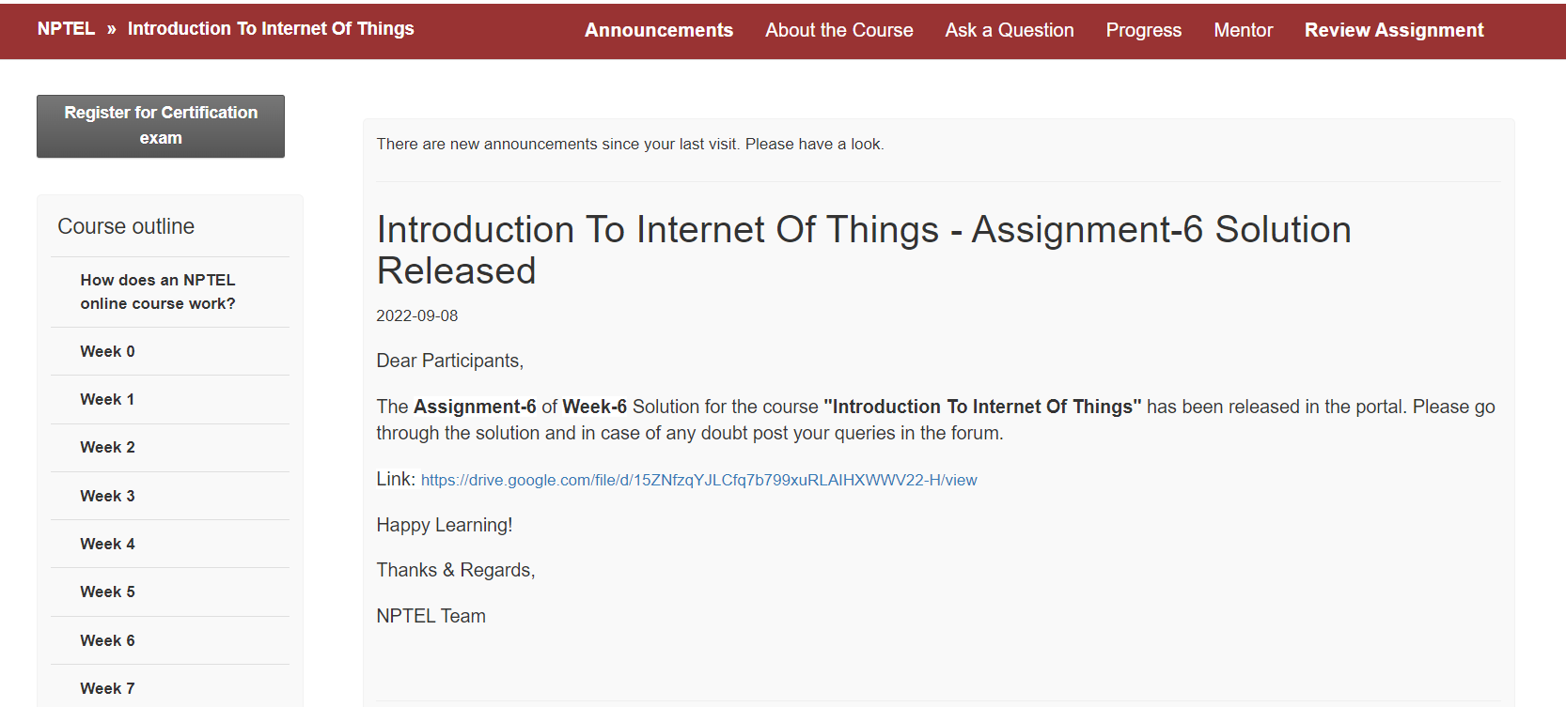
Heuristic evaluation of Swayam application — a UX case study
2. Match between System and Real World
Swayam uses terms like “Certification”, “courses”, and any other terminology that is catchy and familiar to the user. Real-world conventions are followed. Also, we can download the lecture material for offline reference
Heuristic Violated: NO

Slide 22
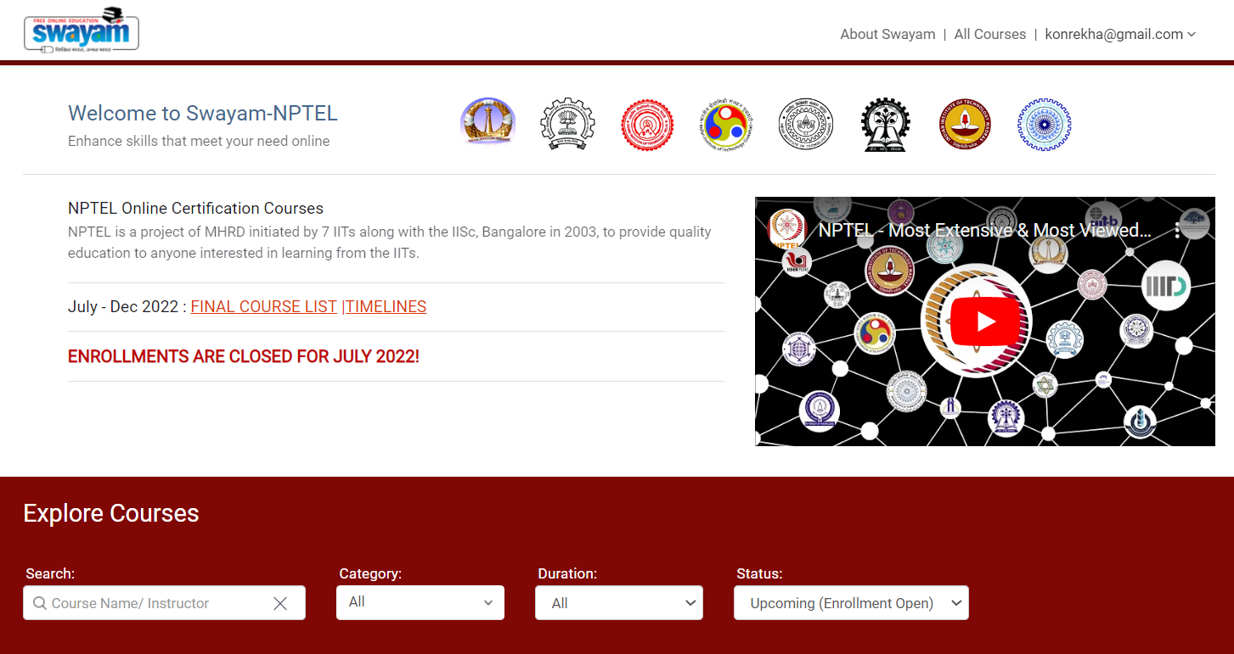
Heuristic evaluation of Swayam application — a UX case study
3. User Control and Freedom
At any point of time, the user can switch to any option in the web application. The user also has the freedom to play an video or go through the content at any time of the course duration and after the course duration also.
Heuristic Violated: No

Slide 23
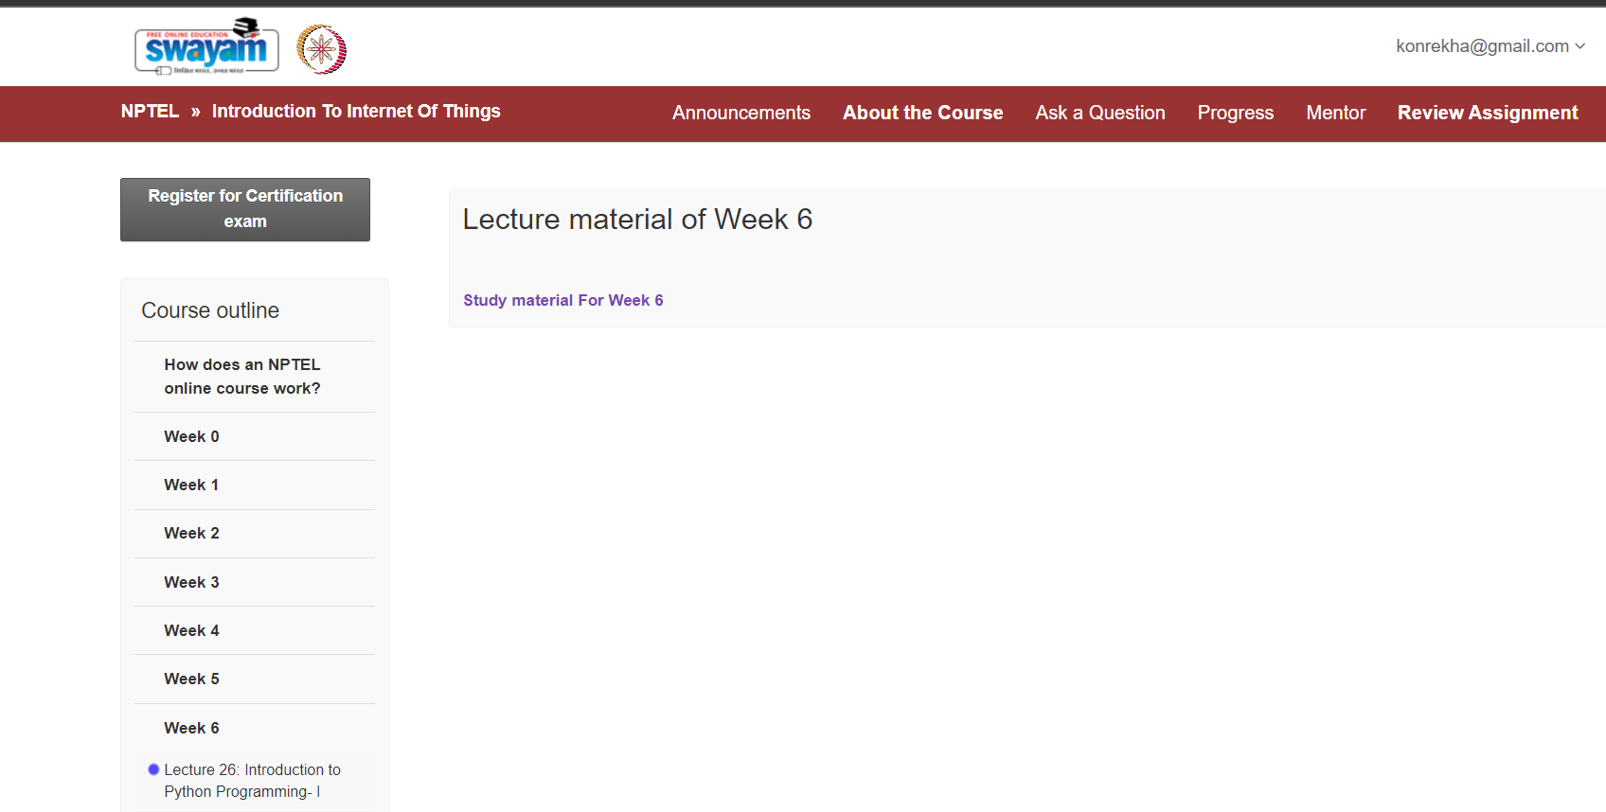
Heuristic evaluation of Swayam application — a UX case study
4. Consistency and Standards
maintains consistency by checking the course outline on the left pane and courses menu on the top right corner and profile details on the top right corner which is convenient to the users and does not makes them think much.
Heuristic Violated: No

Slide 24
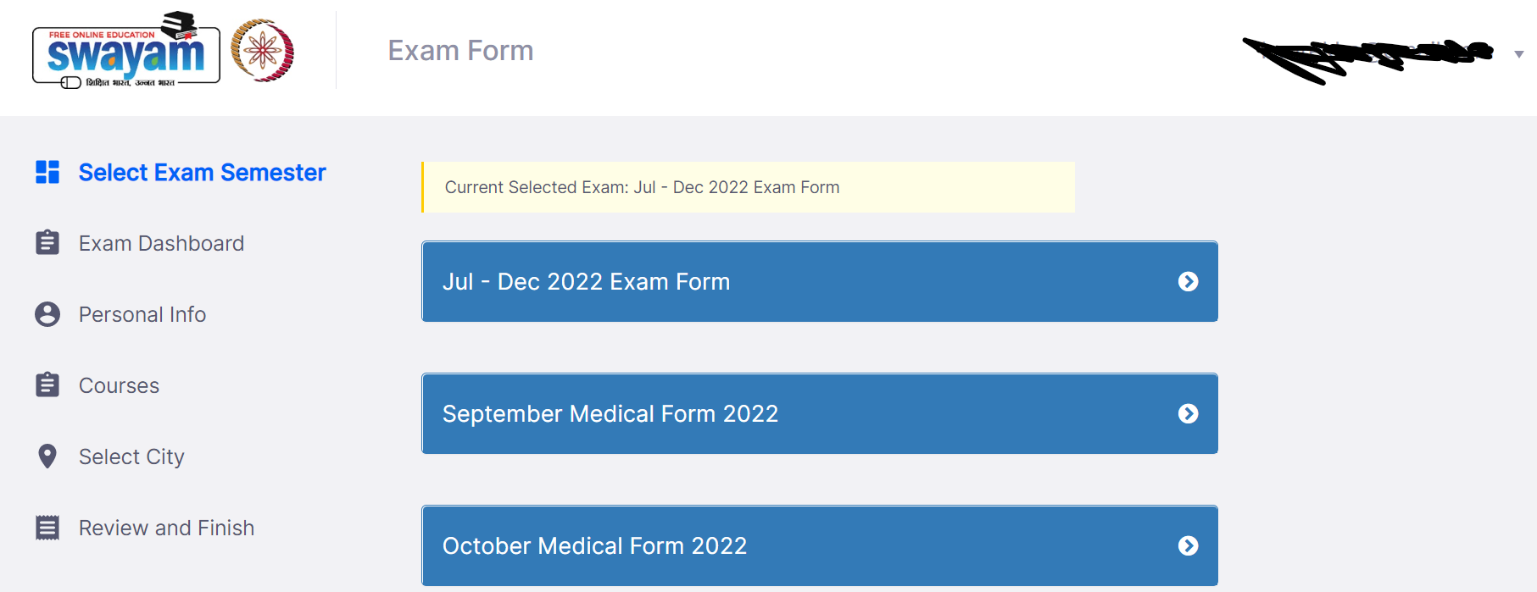
Heuristic evaluation of Swayam application — a UX case study
5. Error Prevention
The crucial part of Swayam NPTEL is a certificate that we receive and register for the exam, The web application asks for the registration details where all details like Photo, signature, and all other details pertaining to exam registration and certificate printing are duly validated to avoid Errors.
Heuristic Violated: No

Slide 25
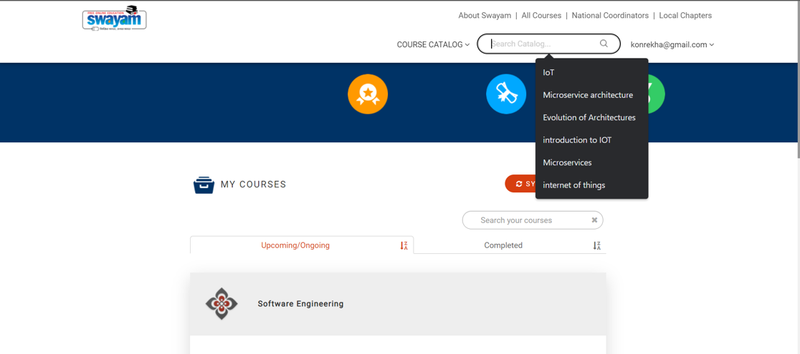
Heuristic evaluation of Swayam application — a UX case study
6. Recognition rather than recall
The “Search” in Swayam minimizes the memory load of users by making options, history, and visible.
Heuristic Violated: No

Slide 26
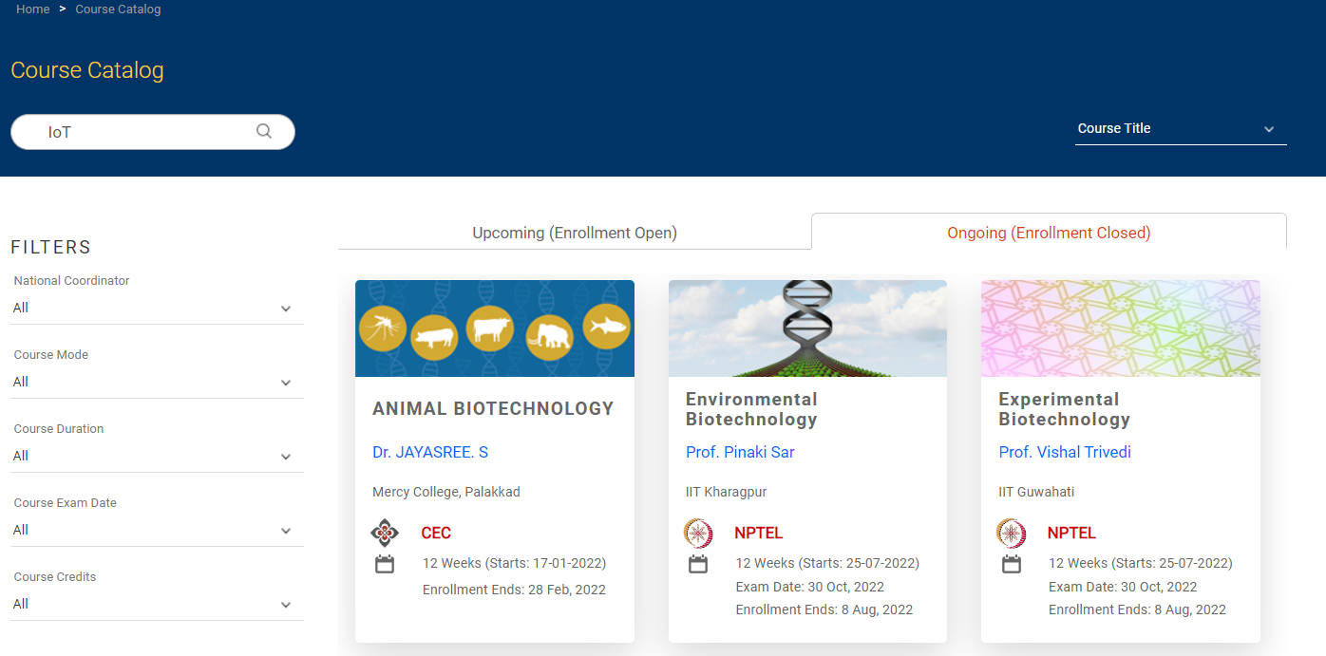
Heuristic evaluation of Swayam application — a UX case study
7. Flexibility and efficiency of use
While a novice user can easily add coursein the default manner, an experienced user can always refine the search by adding filters like duration and type of Course.
Heuristic Violated: No

Slide 27
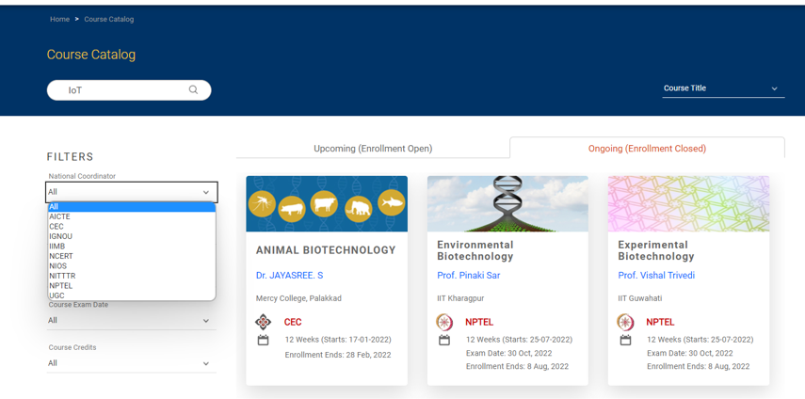
Heuristic evaluation of Swayam application — a UX case study
8. Aesthetic and minimalist design
While searching for the courses, The filters display too many options making the users confused about the selection of the course.
There are too many filter options displaying irrelevant information and leaving users in a confused state.
Heuristic Violated: Yes

Slide 28
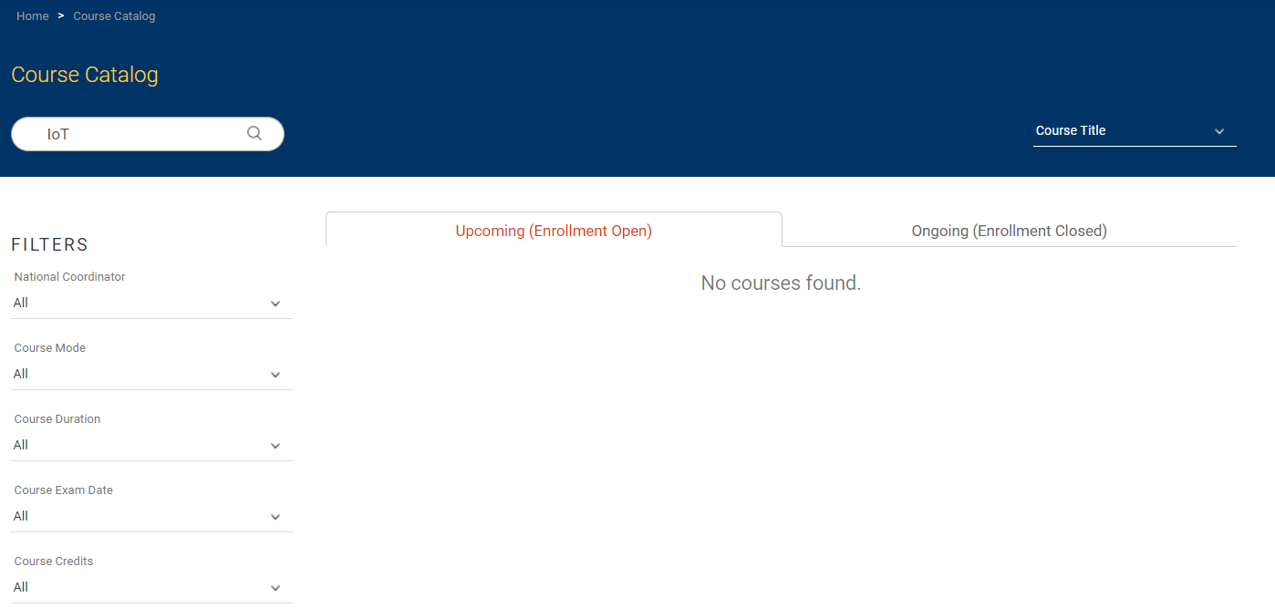
Heuristic evaluation of Swayam application — a UX case study
9. Help users recognize, diagnose, and recover from errors
If a user searches for the course when the enrollment period is over, then no courses will be open and notify the user that No courses are found also on the same page next tab, the application gives information about the Ongoing courses for which enrollment is closed to the users so that they do not panic and are satisfied of being informed that enrollment is closed.
Heuristic Violated: No

Slide 29
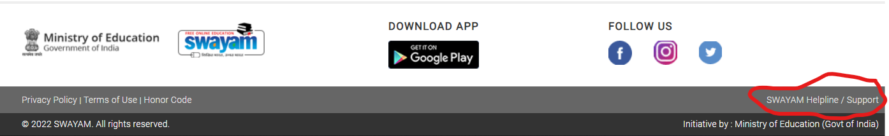
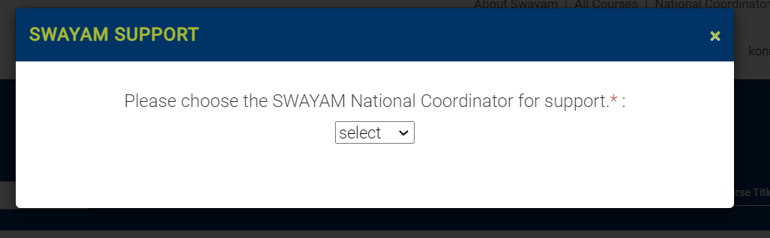
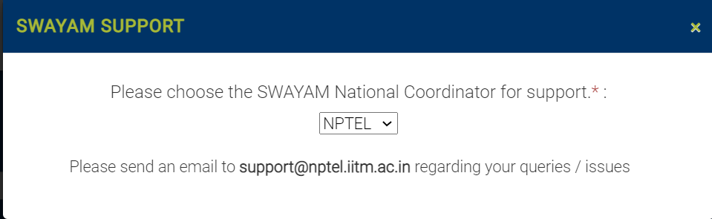
Heuristic evaluation of Swayam application — a UX case study
10. Help and documentation
Swayam provides customer service that provides help/support to the users with the option of call/message. Also, it has documented the FAQs for users to provide them ease in using the application.
Heuristic Violated: No

Slide 30
Heuristic Evaluation for Websites
In recent years, considerable attention has been focused on the web, mobile apps, and other digital technologies. Heuristics for evaluating websites have become increasingly important and several slightly different sets of heuristics have been developed.

Slide 31
Extract from the Heuristics Developed by Budd (2007) that Emphasize Web Design Issues
Clarity: Make the system as clear, concise, and meaningful as possible for the intended audience.
Write clear, concise copy
Only use technical language for a technical audience
Write clear and meaningful labels
Use meaningful icons.
Minimize unnecessary complexity and cognitive load
Make the system as simple as possible for users to accomplish them tasks.
Remove unnecessary functionality, process steps, and visual clutter
Use progressive disclosure to hide advanced features
Break down complicated processes into multiple steps
Prioritize using size, shape, color, alignment, and proximity.

Slide 32
Extract from the Heuristics Developed by Budd (2007) that Emphasize Web Design Issues
Provide users with context
Interfaces should provide users with a sense of context in time and space.
Provide a clear site name and purpose
Highlight the current section in the navigation
Provide a breadcrumb trail
Use appropriate feedback messages
Show the number of steps in a process
Reduce the perception of latency by providing visual cues (e.g. progress indicator) or by allowing users to complete other tasks while waiting.

Slide 33
Extract from the Heuristics Developed by Budd (2007) that Emphasize Web Design Issues
Promote a pleasurable and positive user experience
The user should be treated with respect and the design should be
aesthetically pleasing and promote a pleasurable and rewarding experience.
Create a pleasurable and attractive design
Provide easily attainable goals
Provide rewards for usage and progression.

Slide 34
Turning Design Guidelines into Heuristics
Shneiderman's eight golden rules, a set of guidelines first developed in the mid-1980s, are also frequently adapted for use with different types of systems and environments and used as heuristics for identifying usability problems.
Strive for consistency
Cater to universal usability
Offer informative feedback
Design dialogs to yield closure
Prevent errors
Permit easy reversal of actions
Support internal locus of control
Reduce short-term memory load

Slide 35
Turning Design Guidelines into Heuristics
Strive for consistency
Consistent sequences of actions should be required in similar situations: identical terminology should be used in prompts, menus, and help screens; and consistent color, layout, capitalization, fonts, and so on should be employed throughout.
Exceptions, such as required confirmation of the delete command or no echoing of passwords, should be comprehensible and limited in number.
Cater to universal usability
Recognize the needs of diverse users and design for plasticity, facilitating the transformation of content.
Novice to expert differences, age ranges, disabilities, and technological diversity each enrich the spectrum of requirements that guides design.
Adding features for novices, such as explanations, and features for experts, such as shortcuts and faster pacing, can enrich the interface design and improve perceived system quality.

Slide 36
Turning Design Guidelines into Heuristics
Offer informative feedback
For every user action, there should be system feedback. For frequent and minor actions, the response can be modest, whereas for infrequent and major actions, the response should be more substantial.
Visual presentation of the objects of interest provides a convenient environment for showing changes explicitly.
Design dialogs to yield closure
Sequences of actions should be organized into groups with a beginning, middle, and end.
Informative feedback at the completion of a group of actions gives operators the satisfaction of accomplishment, a sense of relief, a signal to drop contingency plans from their minds, and an indicator to prepare for the next group of actions.
For example, e-commerce websites move users from selecting products to the checkout, ending with a clear confirmation page that completes the transaction.

Slide 37
Turning Design Guidelines into Heuristics
Prevent errors
As much as possible, design the system such that users cannot make serious errors;
Example 1: gray out menu items that are not appropriate and do not allow alphabetic characters in numeric entry fields. If a user makes an error, the interface should detect the error and offer simple, constructive, and specific instructions for recovery.
Example 2: users should not have to retype an entire name-address form if they enter an invalid zip code, but rather should be guided to repair only the faulty part.
Erroneous actions should leave the system state unchanged, or the interface should give instructions about restoring the state.
Permit easy reversal of actions
As much as possible, actions should be reversible.
This feature relieves anxiety since the user knows that errors can be undone, and encourages exploration of unfamiliar options.
The units of reversibility may be a single action, a data-entry task, or a complete group of actions, such as the entry of a name-address block.

Slide 38
Turning Design Guidelines into Heuristics
Support internal locus of control
Experienced users strongly desire the sense that they are in charge of the interface and that the interface responds to their actions.
They don't want surprises or changes in familiar behavior, and they are annoyed by tedious data-entry sequences, difficulty in obtaining necessary information, and inability to produce their desired result.
Reduce short-term memory load
Humans’ limited capacity for information processing in short-term memory (the rule of thumb is that we can remember ‘seven plus or minus two chunks of information) requires that designers avoid interfaces in which users must remember information from one screen and then use that information on another screen.
It means that smartphones should not require a re-entry of phone numbers, website locations should remain visible, multiple-page displays should be consolidated, and sufficient training time should be allotted for complex sequences of actions.

Slide 39
Doing Heuristic Evaluation (Process)
Heuristic evaluation has three stages:
The briefing session: In this stage, the experts are told what to do. A prepared script is useful as a guide to ensure each person receives the same briefing.
The evaluation period:
In this stage, each expert typically spends 1–2 hours independently inspecting the product, using the heuristics for guidance.
The experts need to take at least two passes through the interface.
The first pass gives a feel for the flow of the interaction and the product’s scope.
The second pass allows the evaluator to focus on specific interface elements in the context of the whole product, and to identify potential usability problems.
If the evaluation is for a functioning product, the evaluators need to have some specific user tasks in mind so that exploration is focused.
Suggesting tasks may be helpful but many experts suggest their own tasks. However, this approach is less easy if the evaluation is done early in design when there are only screen mockups or a specification; the approach needs to be adapted to the evaluation circumstances. While working through the interface, specification, or mockups, a second person may record the problems identified, or the evaluator may think aloud. Alternatively, she may take notes herself.
Evaluators should be encouraged to be as specific as possible and to record each problem clearly.
3. The debriefing session: In this stage, the evaluators come together to discuss their findings and prioritize the problems they found and suggest solutions.

Slide 40
Walkthroughs
Walkthroughs have been used by system developers for many years for inspecting code and the concept offers an alternative approach to heuristic evaluation for predicting users’ problems without doing user testing. As the name suggests, walkthroughs involve walking through a task with the product and noting problematic usability features. Below are two types that will be discussed here.
cognitive and
pluralistic walkthroughs.
Both were originally developed for desktop systems but, as with heuristic evaluation, they can be adapted to web-based systems, smartphones and mobile devices, tabletops, and products such as DVD players.

Slide 41
Cognitive Walkthroughs
“Cognitive walkthroughs involve simulating a user's problem-solving process at each step in the human-computer dialog, checking to see if the user’s goals and memory for actions can be assumed to lead to the next correct action”.
The steps involved in cognitive walkthroughs are:
The characteristics of typical users are identified and documented, and sample tasks have been developed that focus on the aspects of the design to be evaluated. A description, mockup, or prototype of the interface to be developed is also produced, along with a clear sequence of the actions needed for the users to complete the task.
A designer and one or more expert evaluators come together to do the analysis.

Slide 42
Cognitive Walkthroughs
3. The evaluators walk through the action sequences for each task, placing it within the context of a typical scenario, and as they do this they try to answer the following questions:
Will the correct action be sufficiently evident to the user? (Will the user know what to do to achieve the task?)
Will the user notice that the correct action is available? (Can users see the button or menu item that they should use for the next action? Is it apparent when it is needed?)
Will the user associate and interpret the response from the action correctly? (Will users know from the feedback that they have made a correct or incorrect choice of action?)
In other words: will users know what to do, see how to do it, and understand from feedback whether the action was correct or not?
4. As the walkthrough is being done, a record of critical information is compiled in which:
The assumptions about what would cause problems and why are identified.
Notes about side issues and design changes are made.
A summary of the results is compiled.

Slide 43
Cognitive Walkthroughs
5. The design is then revised to fix the problems presented. As with heuristic and other evaluation methods, developers and researchers can modify the method to meet their own needs more closely, or adapt the process so that it applies to particular features of mobile or other new technologies
When doing a cognitive walkthrough it is important to document the process, keeping account of what works and what doesn't. A standardized feedback form can be used in which answers are recorded to each question. Any negative answers are carefully documented on a separate form, along with details of the system, its version number, the date of the evaluation, and the evaluators’ names.
Compared with heuristic evaluation, this technique focuses more closely on identifying specific user problems at a high level of detail. Hence, it has a narrow focus that is useful for focusing on certain types of the system rather than for evaluating whole systems.
In particular, it can be useful for applications involving complex cognitive operations. However, it is very time-consuming and laborious to do and evaluators need a good understanding of the cognitive processes involved.

Slide 44
Pluralistic Walkthroughs
“Pluralistic walkthroughs are another type of walkthrough in which users, developers and usability experts work together to step through a [task] scenario, discussing usability issues associated with dialog elements involved in the scenario steps”.
In a pluralistic walkthrough, each of the evaluators is asked to assume the role of a typical user. Scenarios of use, consisting of a few prototype screens, are given to each evaluator who writes down the sequence of actions they would take to move from one screen to another, without conferring with fellow panelists.
Then the panelists discuss the actions they each suggested before moving on to the next round of screens. This process continues until all the scenarios have been evaluated.

Slide 45
Pluralistic Walkthroughs
Advantages
The benefits of pluralistic walkthroughs include a strong focus on users’ tasks at a detailed level, i.e. looking at the steps taken.
This level of analysis can be invaluable for certain kinds of systems, such as safety-critical ones, where a usability problem identified for a single step could be critical to its safety or efficiency.
The approach lends itself well to participatory design practices by involving a multidisciplinary team in which users play a key role.
Furthermore, the group brings a variety of expertise and opinions for interpreting each stage of interaction.
Limitations
Limitations include having to get all the experts ether at once and then proceed at the rate of the slowest.
Furthermore, only a limited number of scenarios, and hence paths through the interface, can usually be explored because of time constraints.

Slide 46
Analytics
Analytics is a method for evaluating user traffic through a system – mostly such systems involve selling a product or service so knowing what customers do and want is important for improving the product or service, but analytics are also being used for evaluating non-transactional. When used to examine traffic on a website or part of a website, the analytics are known as web analytics.
Web analytics can be collected locally or remotely across the Internet by logging user activity, counting and analyzing the data in order to understand what parts of the website are being used and when.
Many companies are developing their own analytics tools; others use the services of companies such as Google and VisiStat, which specialize in providing analytics and the analysis necessary to understand large volumes of data.
Typically these companies present their analysis in forms that are easy for developers and website managers to understand – e.g. as graphs, tables, and other types of data visualizations.

Slide 47
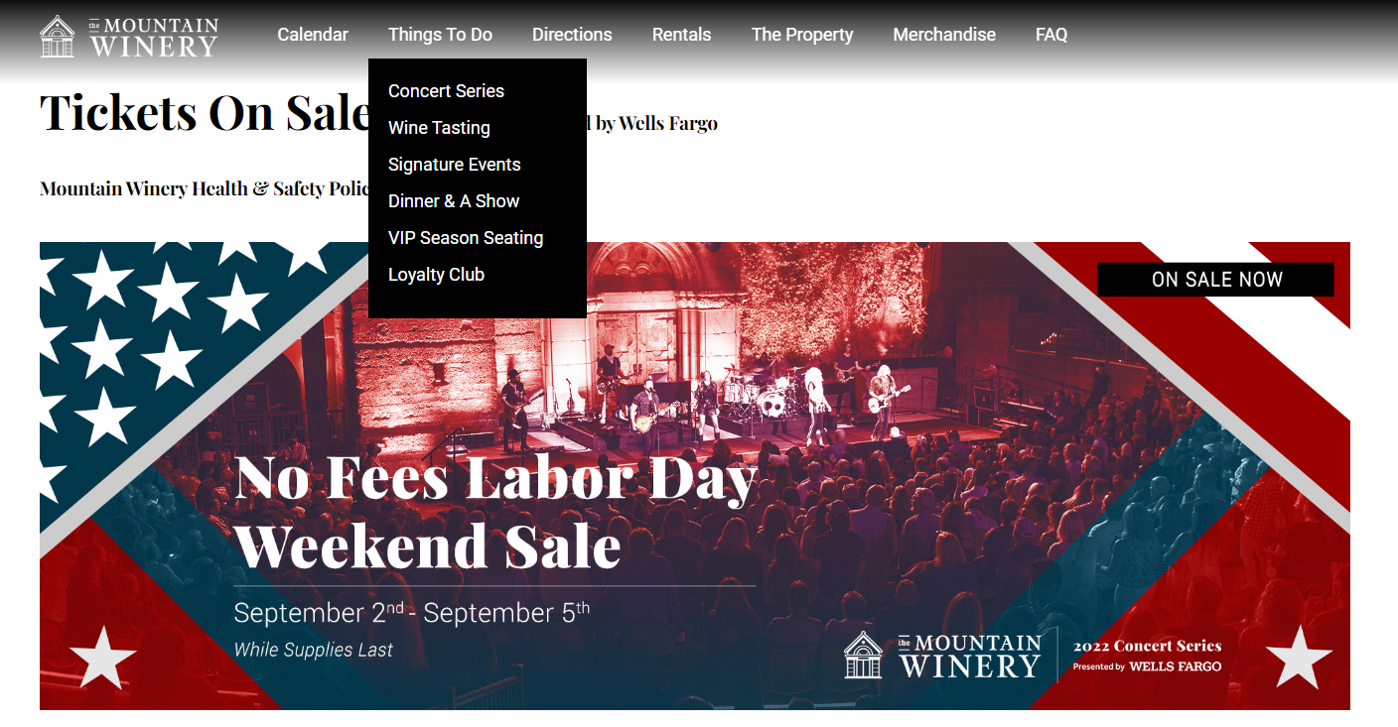
Analytics - Example

Slide 48
Analytics - Example
Mountain Wines, located in Saratoga, California, aims to create memorable experiences for guests who visit the vineyard. Following on the tradition started by Paul Masson, world famous wine maker, Mountain Wines offers a beautiful venue for a variety of events including weddings, corporate meetings, dinner parties, birthdays, concerts, and vacations.
Mountain Wines uses a variety of advertising media to attract customers to its website and in 2010 invested about $10 000 a month in advertising. However, the website has remained unchanged for several years because the company didn't have a way of evaluating its effectiveness and could not decide whether to increase or decrease investment in it.
They then decided to employ VisiStat, to use their web analytics tool. Prior to enlisting this company, the only record that Mountain Wines had of the effectiveness of its advertising came from its front-desk employees who were instructed to ask visitors ‘How did you hear about Mountain Wines?’

Slide 49
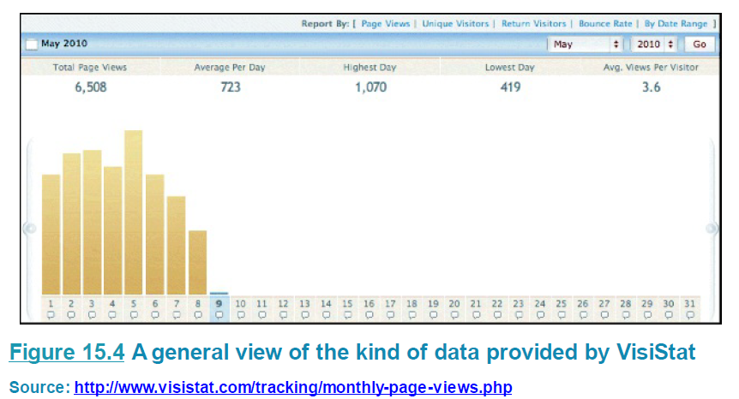
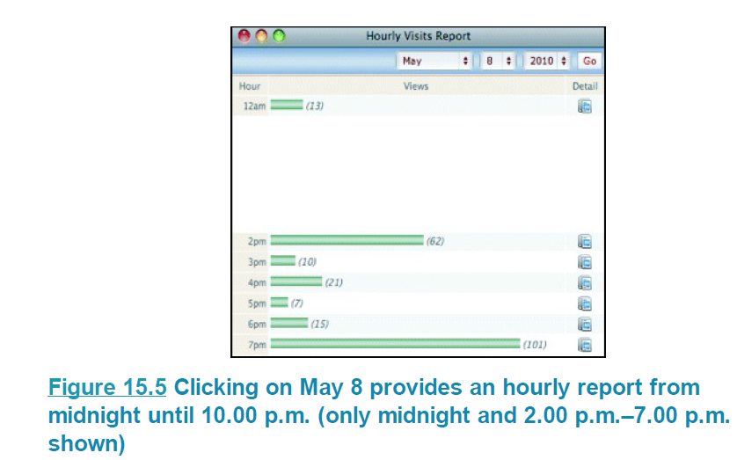
Analytics - Example
VisiStat provided Mountain Wines with data showing how their website was being used by potential customers, e.g. data like that shown in Figures 15.4 to 15.6. Figure 15.4 provides an overview of the number of page views of the website per day. Figure 15.5 provides additional details and shows the hour-by-hour traffic. Clicking on the first icon for more detail shows where the IP addresses of the traffic are located (Figure 15.6).

Slide 50
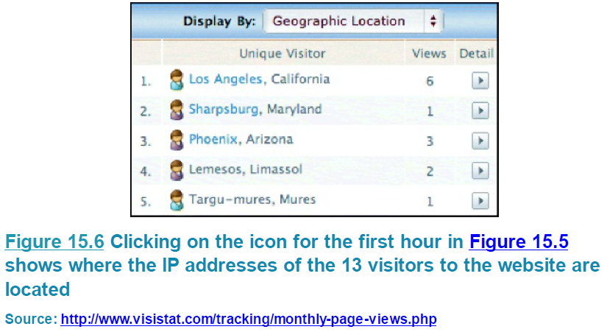
Analytics - Example
Using this data and other data provided by VisiStat, Mountain Wines could see visitor totals, traffic averages, traffic sources, visitor activity, and more. They discovered the importance of visibility for their top search words; they could pinpoint where guests were going on their website, and they could see where their guests were geographically located.

Slide 51
Predictive Models
Similar to inspection methods and analytics, predictive models evaluate a system without users being present. Rather than involving expert evaluators role-playing users as in inspections, or tracking their behavior as in analytics, predictive models use formulas to derive various measures of user performance.
Predictive modeling provides estimates of the efficiency of different systems for various kinds of tasks. For example, a smartphone designer might choose to use a predictive model because it can enable her to determine accurately which is the optimal layout of keys on the phone for allowing common operations to be performed.
Two types of predictive models have been particularly influential in HCI and interaction design over the years: Fitts’ Law, which will be discussed in detail, and the GOMS family of models (Card et al, 1983), which are rarely used now as the tools were designed in the early 1980s, primarily for comparing PC-based interfaces for tasks that were highly predictable.

Slide 52
THANK YOU

